Slide 1
Syllable Division
Slides for the classroom

Slide 2
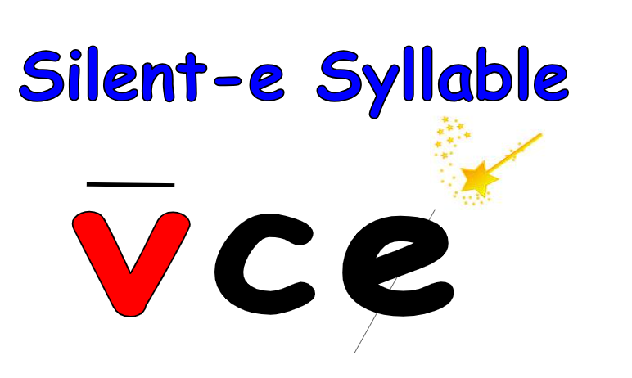
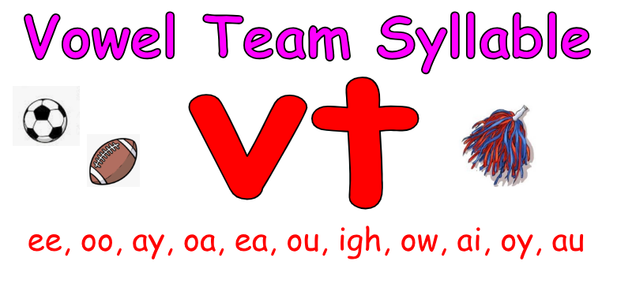
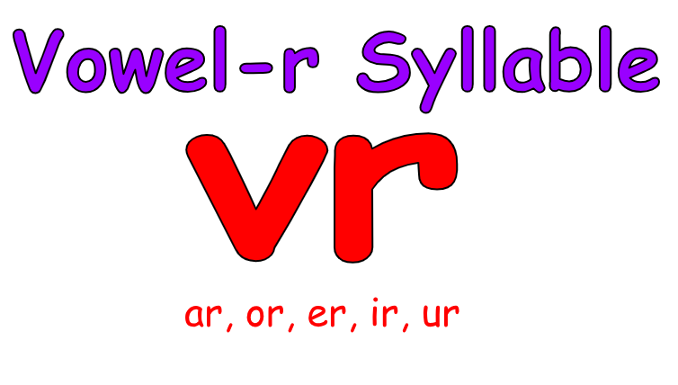
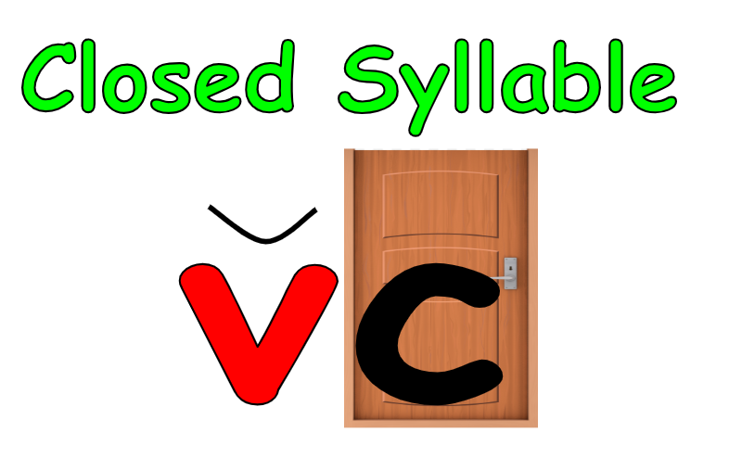
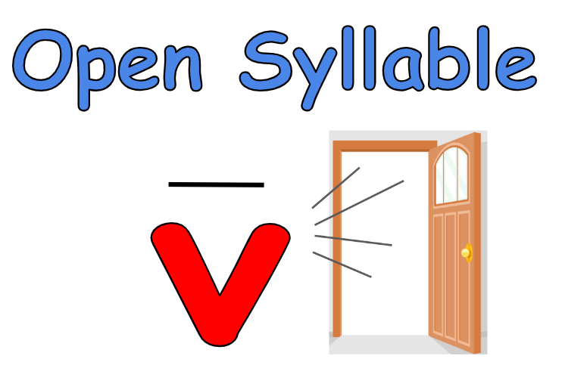
Syllable House
VCE
silent-e
VT
vowel team
VR
par
vow
plete
VC
closed
V
open
bit
ti

Slide 3
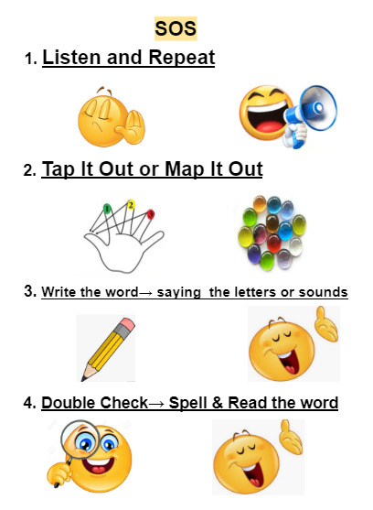

Slide 4
Why is syllable division important?
Review of Syllable Types
Syllable Division
Rabbit / Ostrich
Tiger
Robin
Turtle
Lion

Slide 5
SAMPLE Discovery ApproachTeaching syllables
Use discovery method
Listen to these words, what do you notice?
How many syllable are in the word?
“rabbit, napkin, kitten”
Let’s look at the words: rabbit, napkin, kitten What do you notice?
How many vowels are in each word?
What do you see in the middle of each word?
What do you notice about the two syllables?

Slide 6
Why do we learn about syllable types?
It’s hard to figure out the vowel sound in a word
There are so many vowel sounds and ways to write the sounds
Words have patterns = the kind of syllable
Word patterns help to figure out the sound of the vowel
It helps spelling and reading of words
It helps to figure out words with many syllables

Slide 7
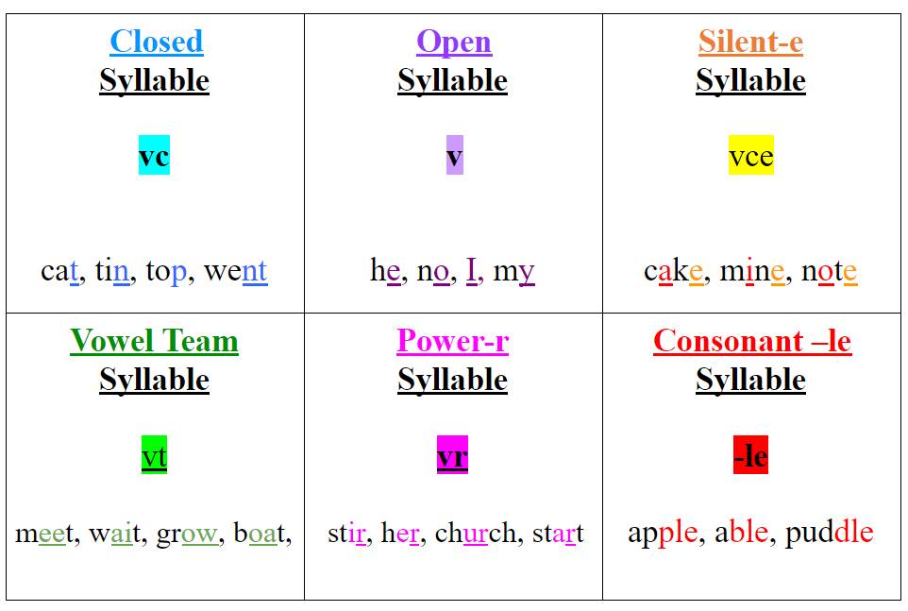

Slide 8
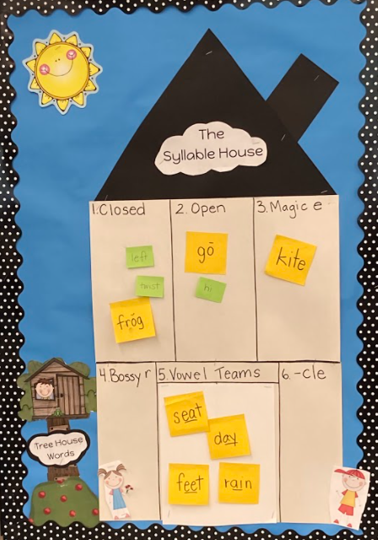
The
Syllable House

Slide 9
Terms used relating to sounds and words
Breve /brev/ :
the diacritical mark appearing over a vowel grapheme that that the vowel is short. signifies
Macron /ma kroon/:
the diacritical mark over a vowel grapheme that is long.

Slide 10

Compound words
A word that is made up of two or more smaller words
whose meaning is related to those words:
bookcase
lamppost
backpack
“Look for the two words in the one long word.”

Slide 11
Syllable
Has one vowel sound
Is a beat in a word (a breath)
v

Slide 12
The pattern is_________
The syllable type is _______
The vowel sound is ________
V
open
VC
closed
VCE
silent e
de
rab
lete
bit

Slide 13
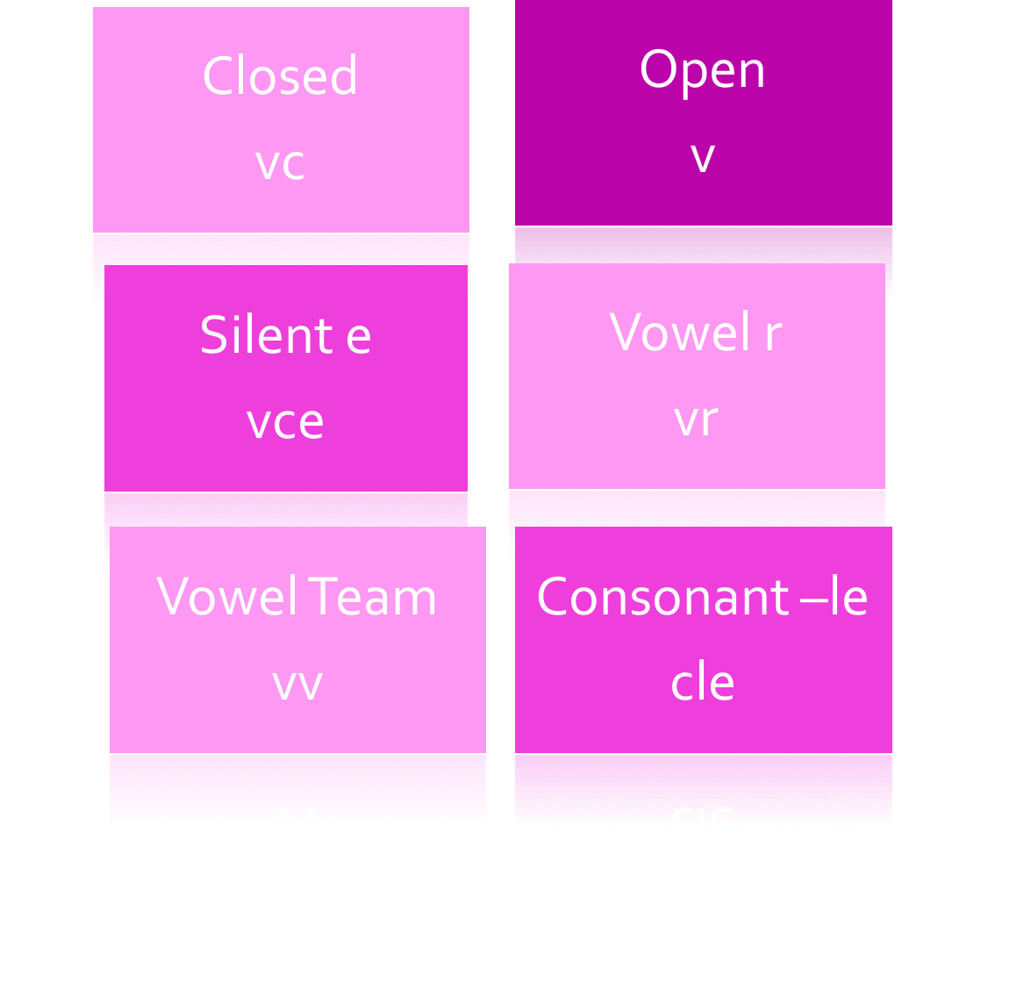
Six syllable types

Slide 14
V
open
VC
closed
VCE
silent e
VV
vowel team
VR
mighty-r
ti
bit
plete
vow
par

Slide 15
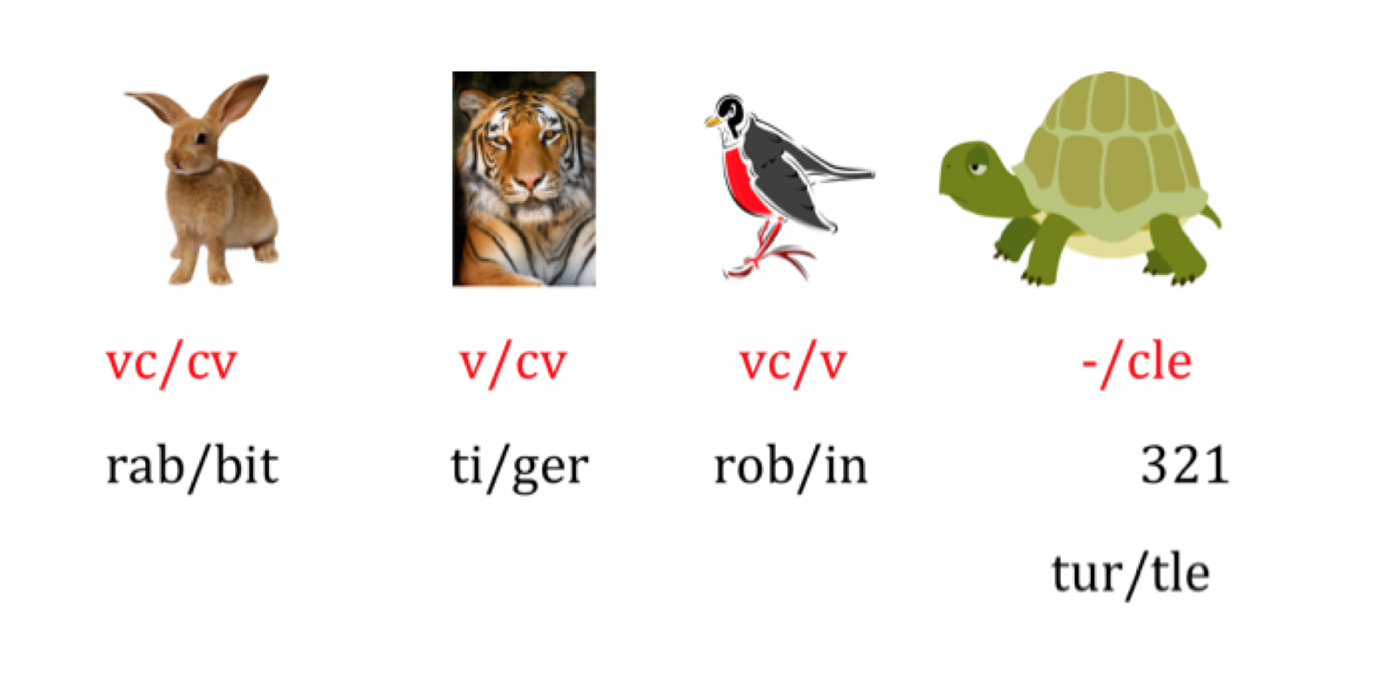
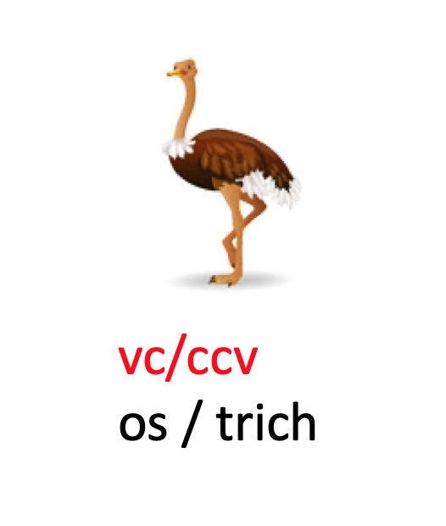

Slide 16
Syllable Division
Prerequisite student knowledge:
Basic letter-sounds including digraphs and blends
Ability to decode and encode 1 syllable words
1 syllable/ 1 vowel sound concept
Knowledge of syllable types (closed syllable)
v

Slide 17
Syllabication
The process of analyzing the
patterns of vowels & consonants
in a word to determine where the
word breaks into syllables.
Enables readers to identify syllable types & vowel sounds → to read & spell words
v

Slide 18
Beginning with the Oral Activities
Counting syllables – clapping, chin drop, punching it out, hopping it out
Simple to complex 1 & 2 syllables / 1- 3 syllables / 1-5 syllables
Phonological Awareness: “Say rabbit and say it without the rab” → “bit”
Use phoneme – grapheme mapping
LINK to curriculum words- especially content areas of Social Studies & Science
ROSNER: Test of Auditory Analysis Skills &
CORE

Slide 19
Phoneme – Grapheme Mapping

Slide 20
Phoneme – Grapheme Mapping
r | a | b |  | b | i | t

Slide 21
Reading Multisyllabic Words
Basic Concepts of Syllable Division:
Division of words determines pronunciation of syllables →vowels
Each syllable has one and only one vowel phoneme/sound (may have more vowel letters)
Syllable division is based on position – patterns-
of vowels & consonants
v

Slide 22
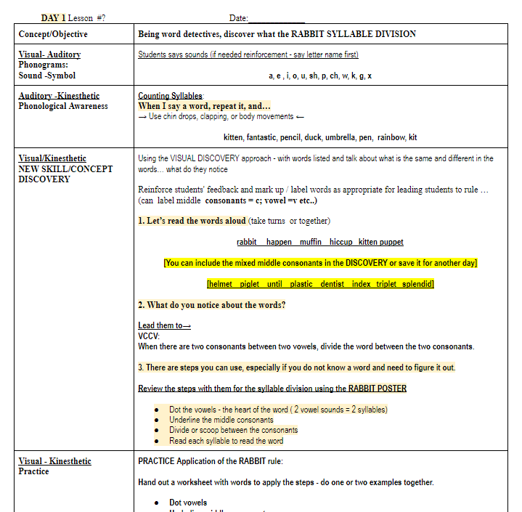
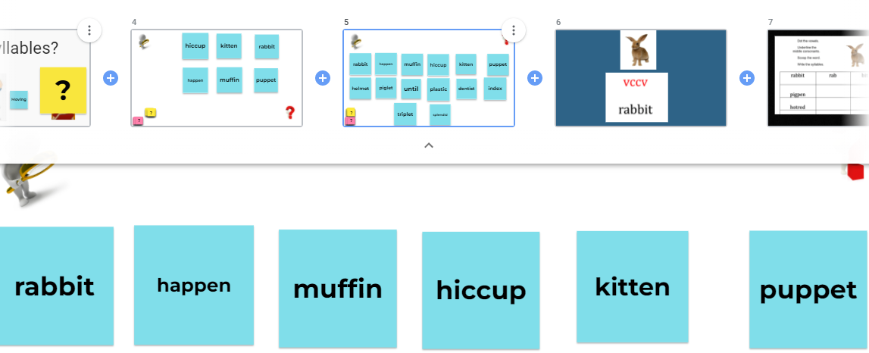
Sample Class Lesson & Jamboard Template in the Drive☺

Slide 23
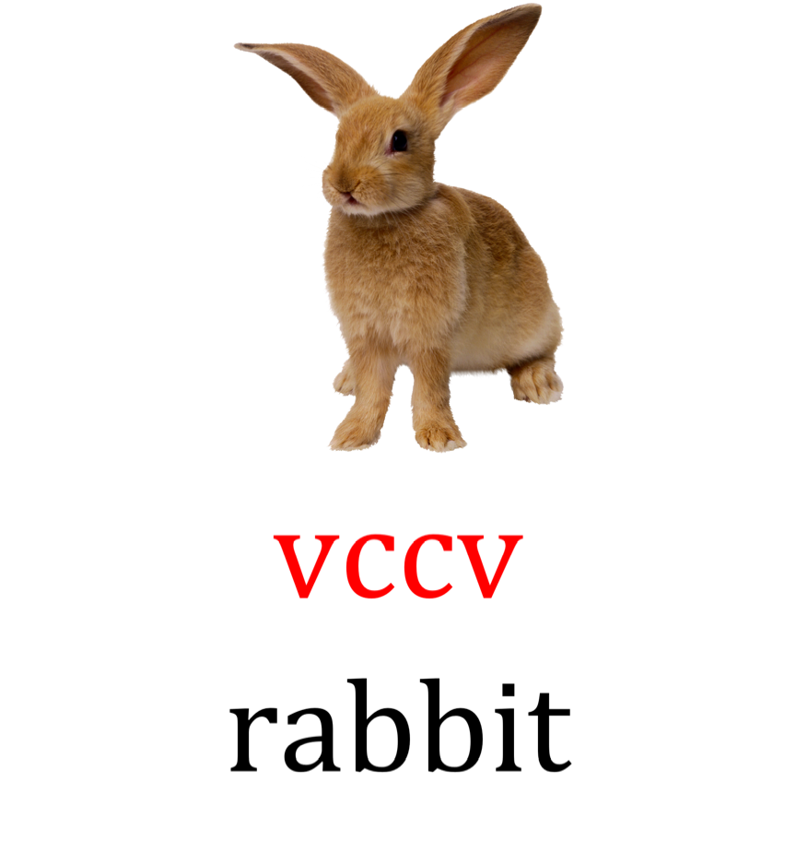
Spot & Dot the vowels (underneath)
Underline the middle consonants
Divide between the two consonants-
Scooping or dividing the word
Read each syllable, read the word

Slide 24
1. Spot & Dot the vowels.
2. Underline the middle consonants.
3. Divide the word between the consonants
4. Read each of the syllables.
5. Read the word.

Slide 25
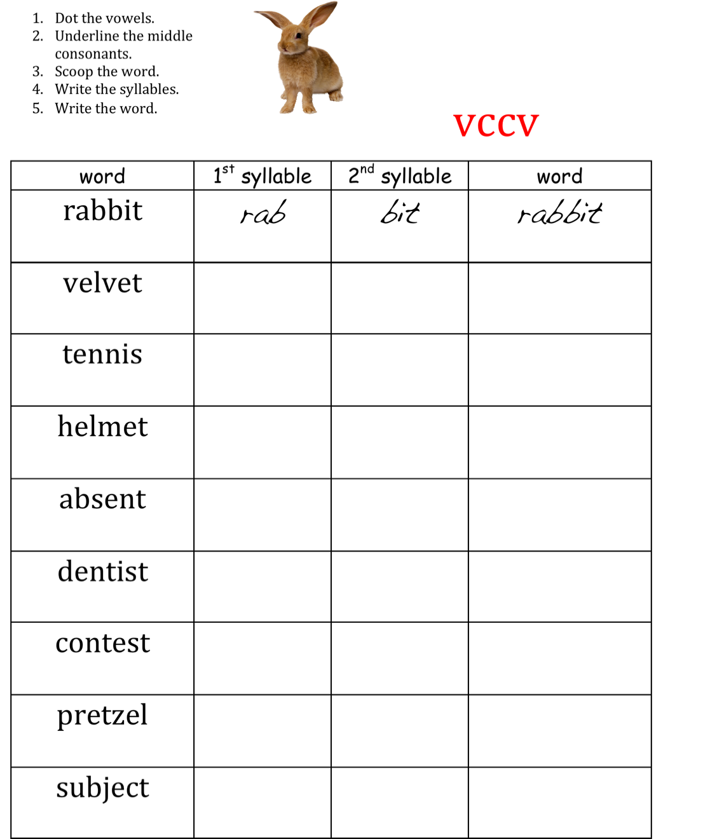

Slide 26
First syllable can be an closed syllable (short) or
Vowel –r vowel sound

Slide 27
c/c | c/vr vr/vr Vr/c | c/se
napkin | inform | pancake
until | order | invite
absent | perform | dispute
subject | confirm | bonfire
 | furnish | empire

Slide 28
APPLYING SPELLING PROCEDURES:
SOS to 2+ SYLLABLE WORDS
Say the word
Students repeat the word
Students say the first syllable, taps it, and writes it.
Students say the word (can skip this step dependent on students’ memory)
Students say the second syllable, taps it and writes it.
Students check word
SCAFFOLDING TO SUPPORT SPELLING:
Use phoneme mapping or
Use phoneme grapheme mapping at the beginning to support students
Use columns to break down 1st syllable + 2nd syllable = word

Slide 29
75% of English syllables
Closed Syllables
43%
Open
Syllables
32%
Unlocking Literacy (2003)
by Marcia K. Henry

Slide 30
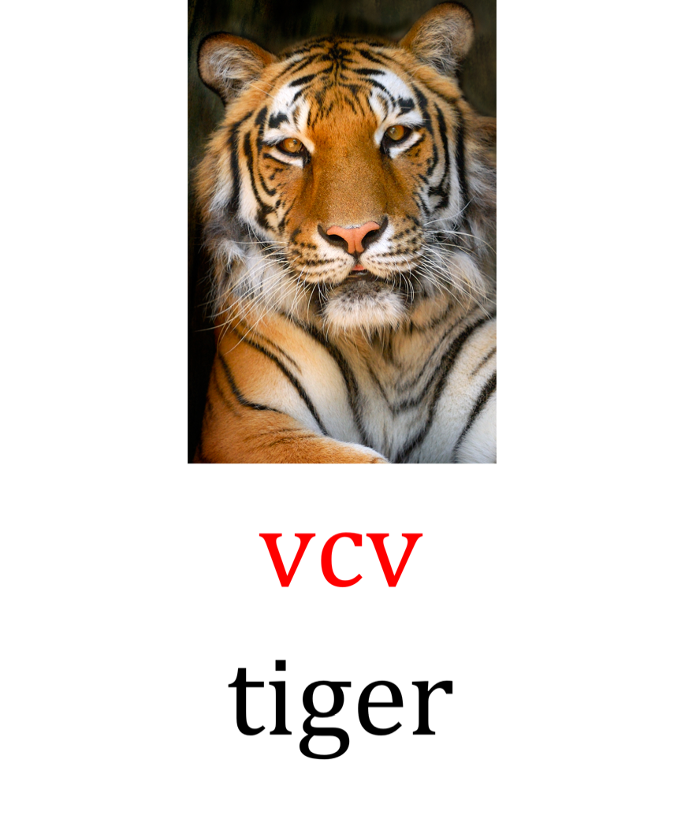
Spot & Dot the vowels (underneath)
Underline the middle consonant
Divide after the first vowel
scooping or dividing the word
Read each syllable, read the word

Slide 31
First syllable will always be an
open syllable =
long vowel sound

Slide 32
hotel | eject
depend | beside
basic | behave
unit | eject
pretend | rotate
robot | beneath
humid | predict
1. Spot & Dot the vowels.
2. Underline the middle consonant.
3. Divide the word after the first vowel
4. Read each of the syllables.
5. Read the word.

Slide 33
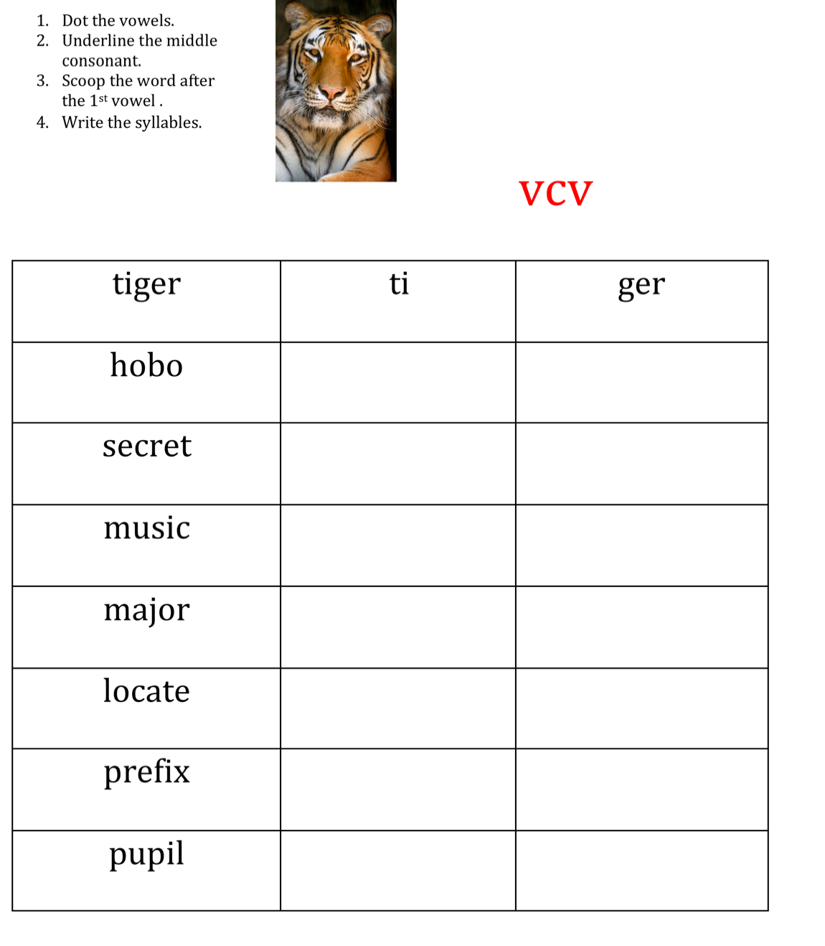

Slide 34
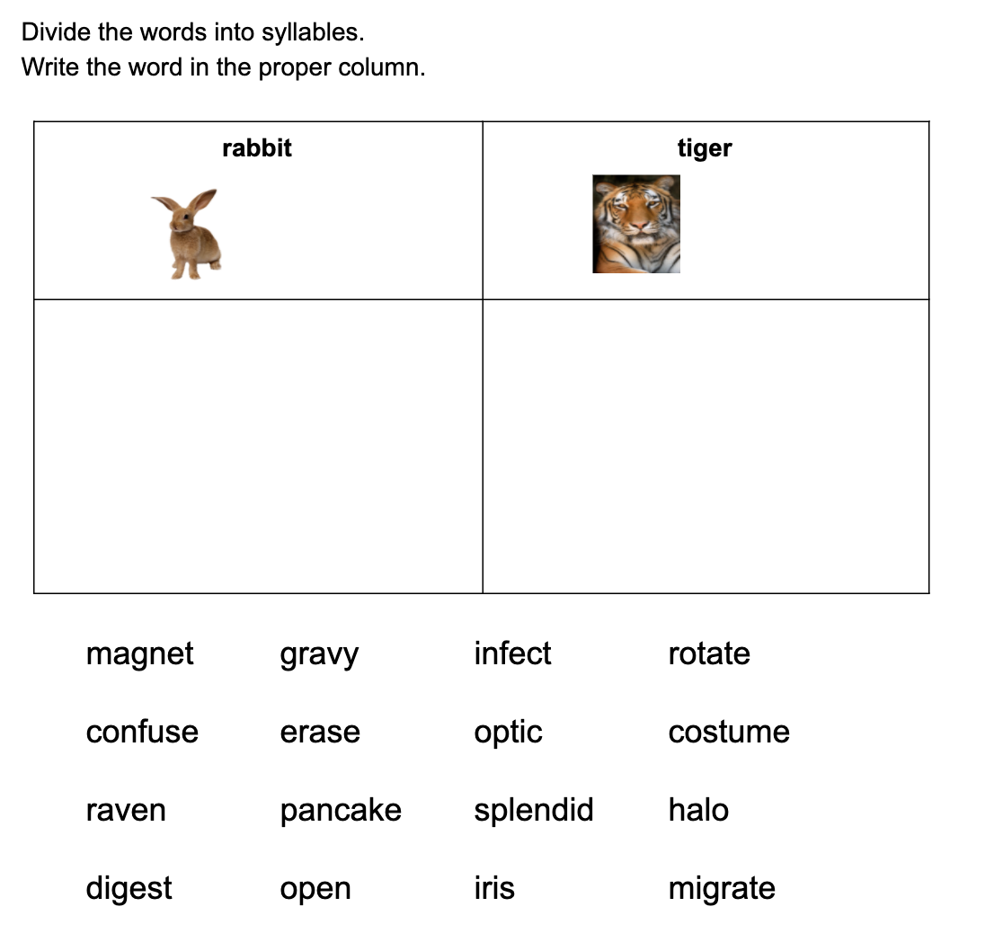

Slide 35
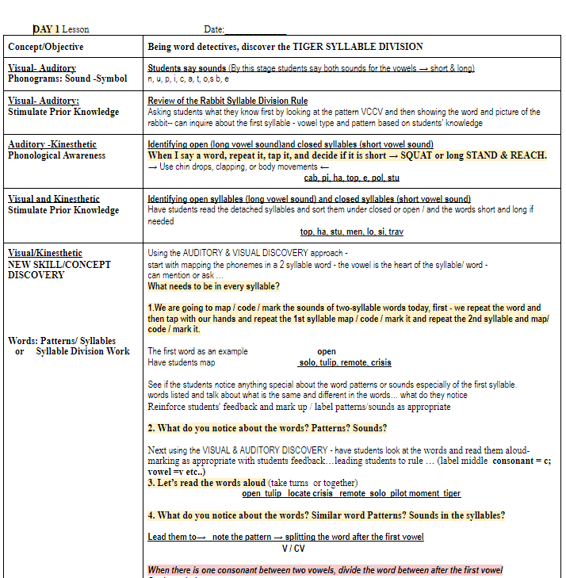
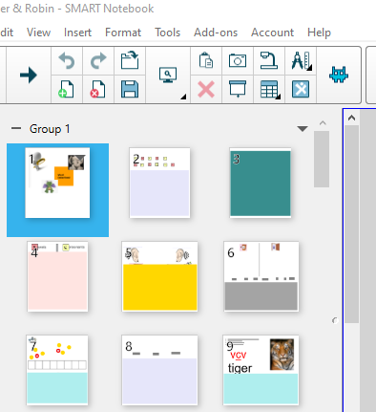
Lesson, Video, & Notebook Template Sample in the Drive☺

Slide 36
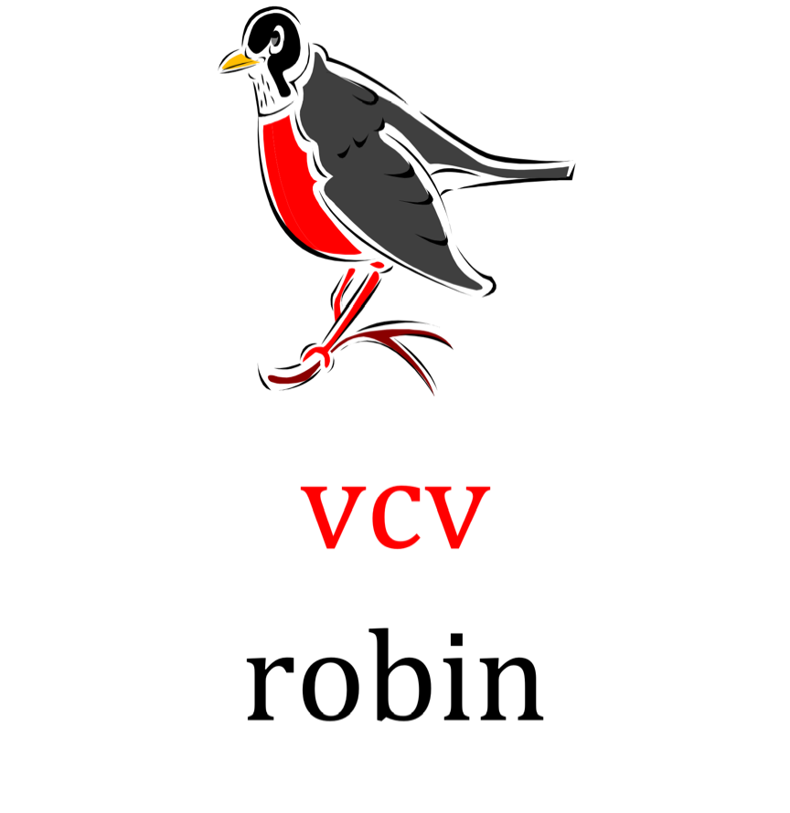
Spot & Dot the vowels (underneath)
Underline the middle consonant
Divide after the middle consonant
scooping or dividing the word
Read each syllable, read the word

Slide 37
THE FIRST SYLLABLE IS USUALLY CLOSED - IT CAN ALSO BE VOWEL-R

Slide 38

cabin | edit
polish | solid
credit | finish
vivid | cabin
menu | panic
lavish | sonic
visit | tonic
limit | static
timid | edit

Slide 39
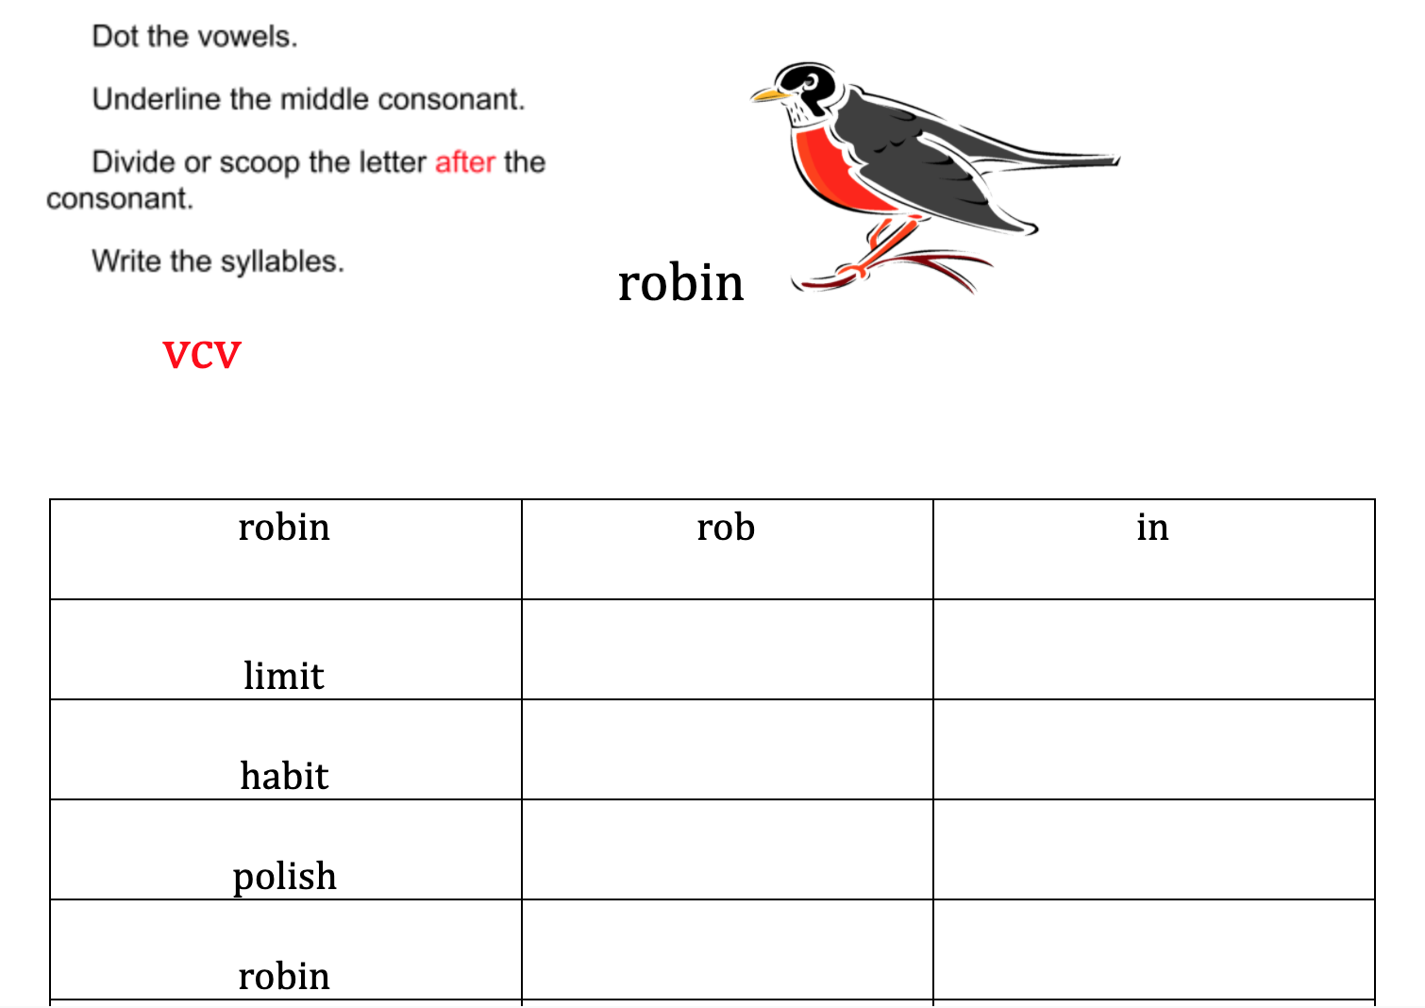

Slide 40
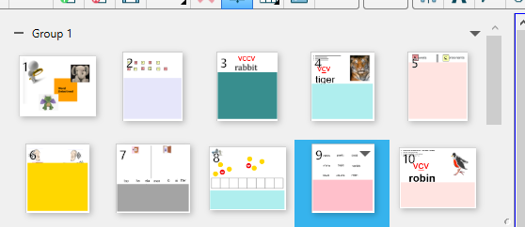
Lesson Notebook Template in the Drive☺
Can use same template as
tiger to make robin lesson (copy is in the robin folder)

Slide 41
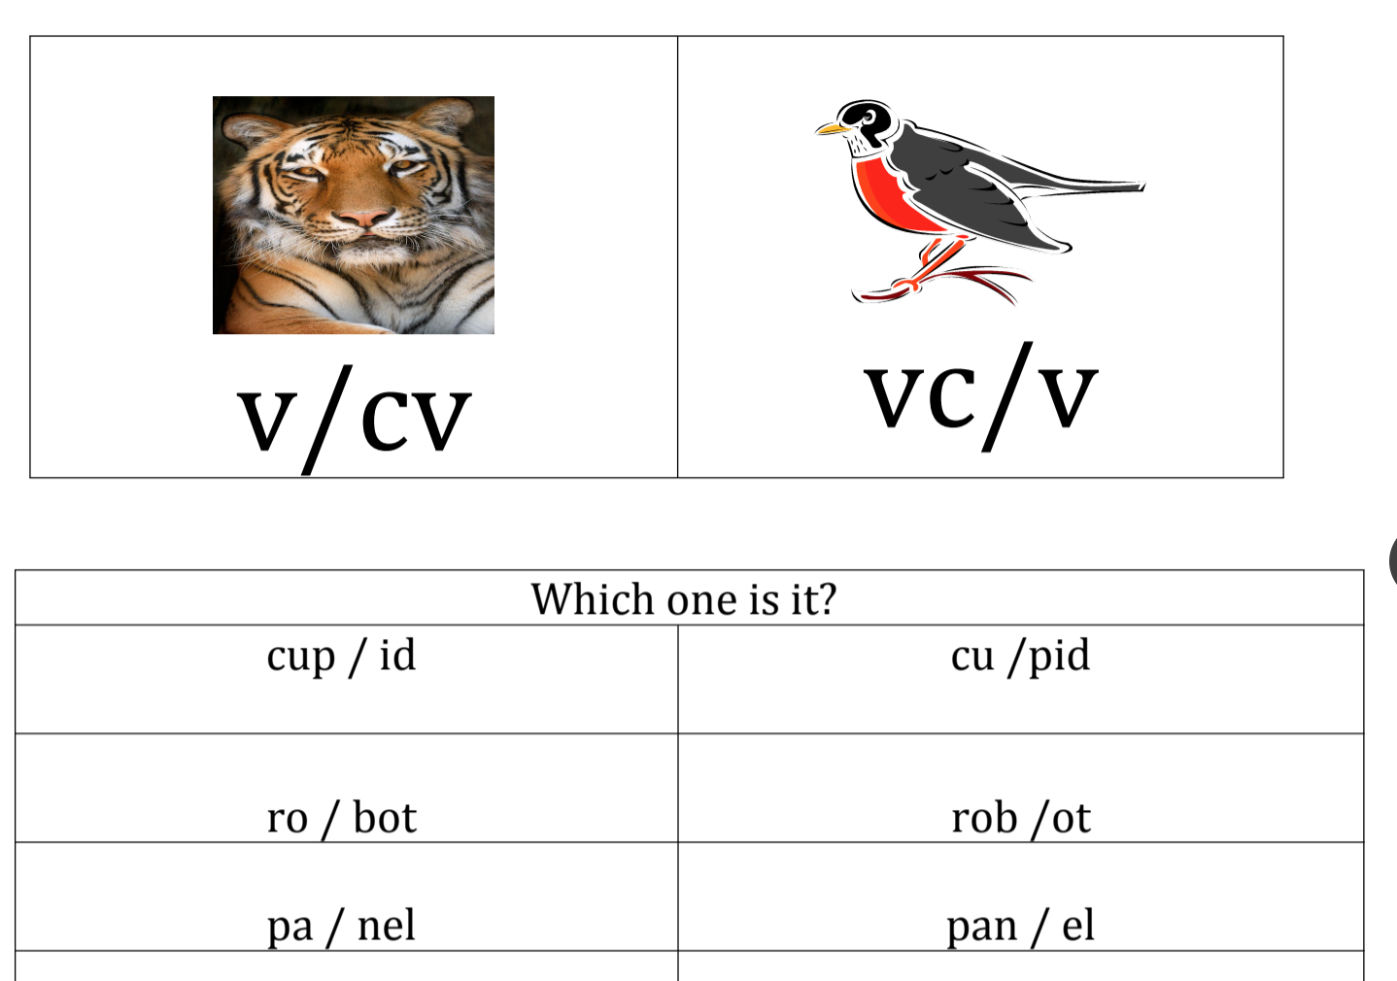

FLEX: Tiger or Robin

Slide 42
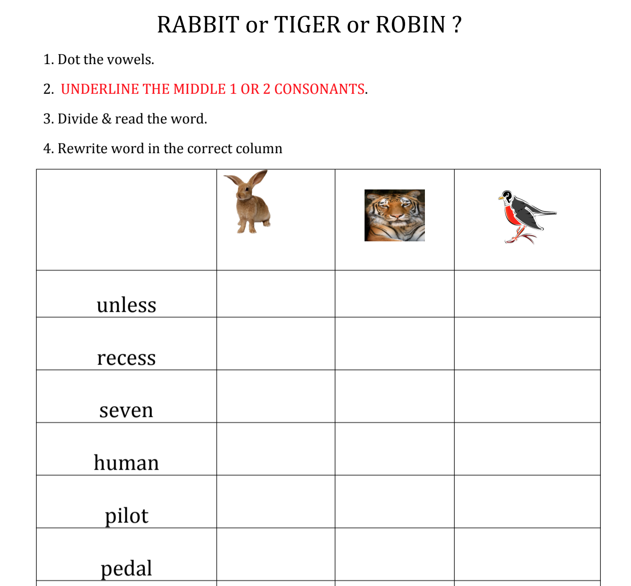

Slide 43
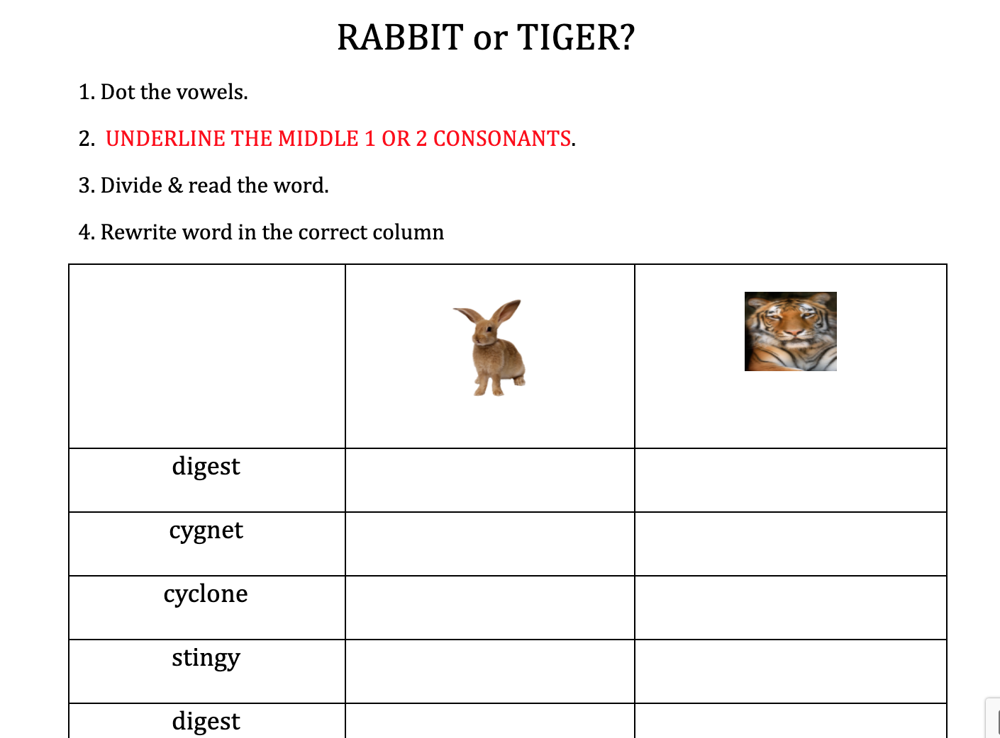
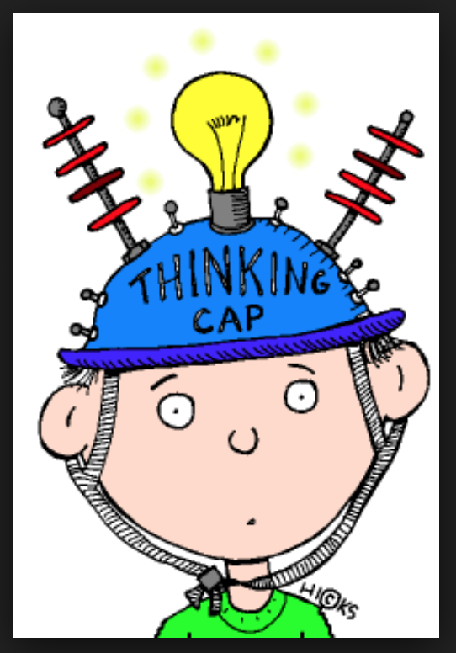

Slide 44
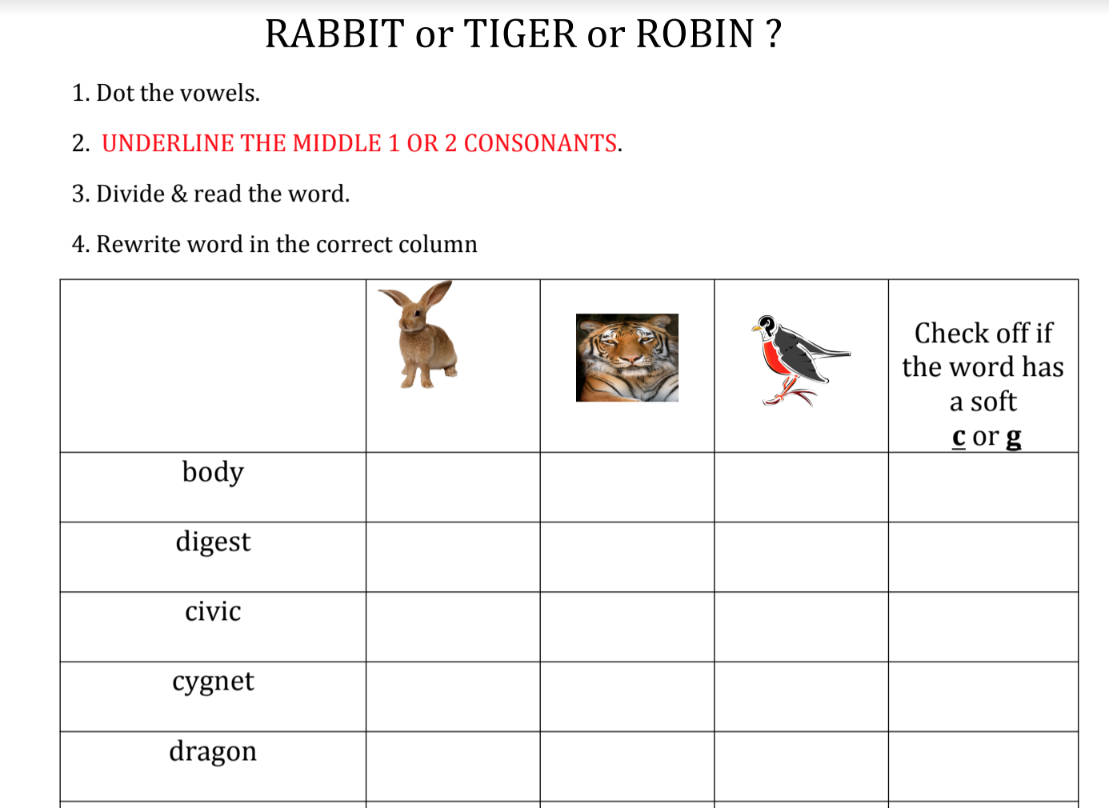

Slide 45
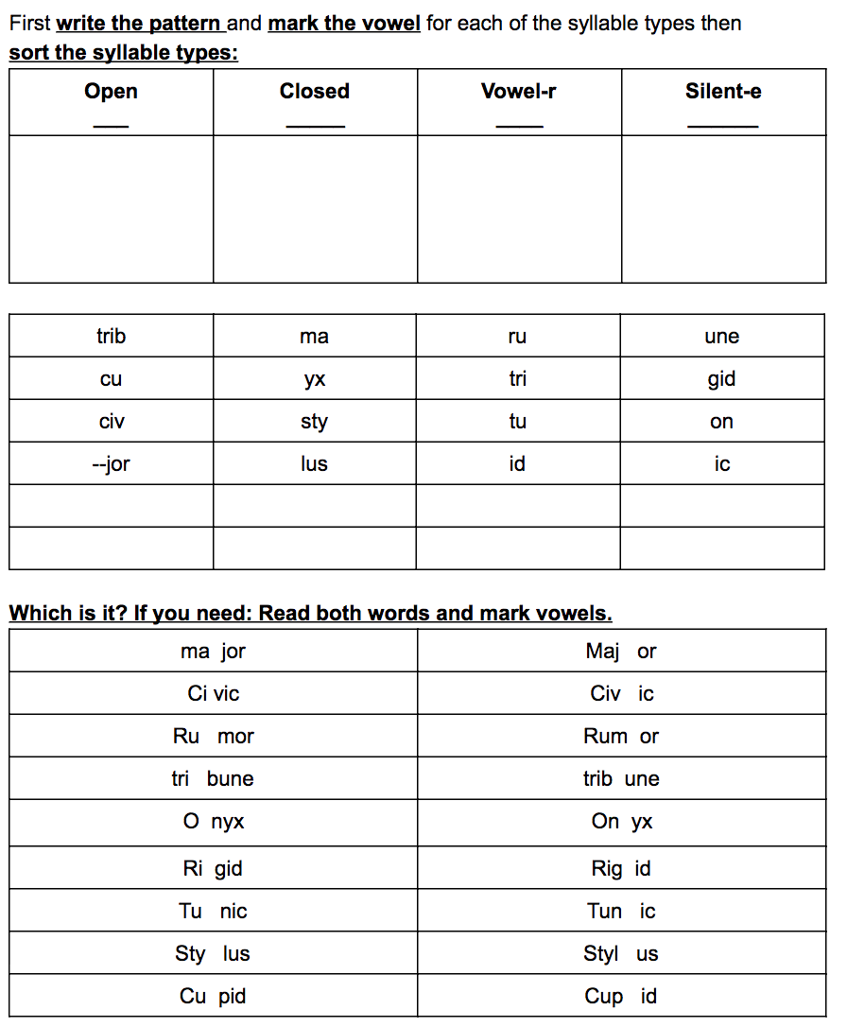
FLEX: Tiger or Robin

Slide 46
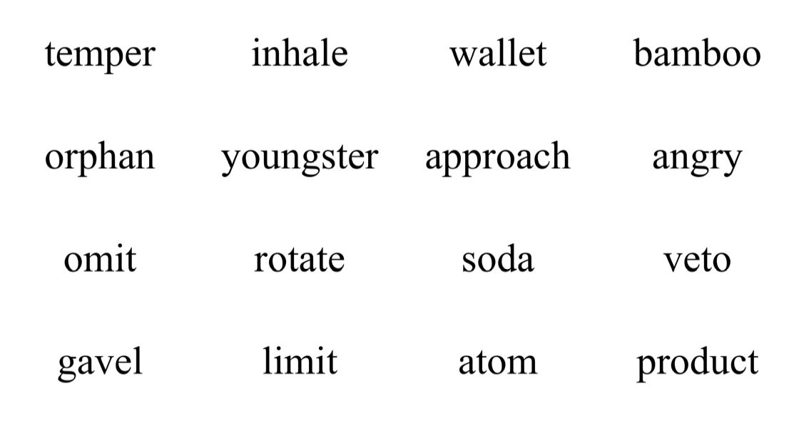
Mixed Practice

Slide 47
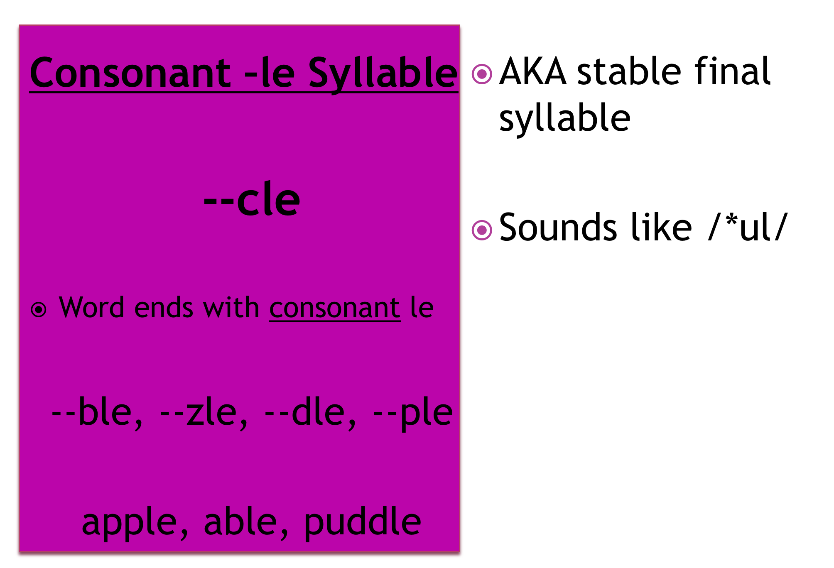
Consonant-le syllables

Slide 48
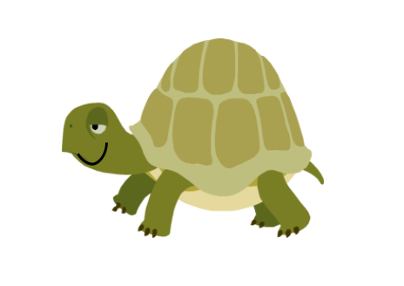
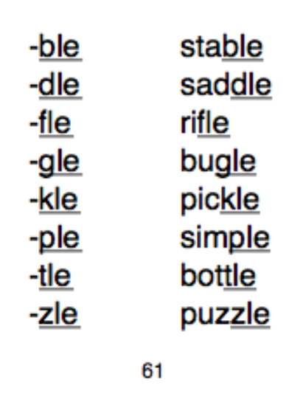
Do you see --CLE at the end of the word?
Count back three!
Divide the word with a scoop or line
Read the syllables & read the word
--cle
turtle
3
2
1

Slide 49
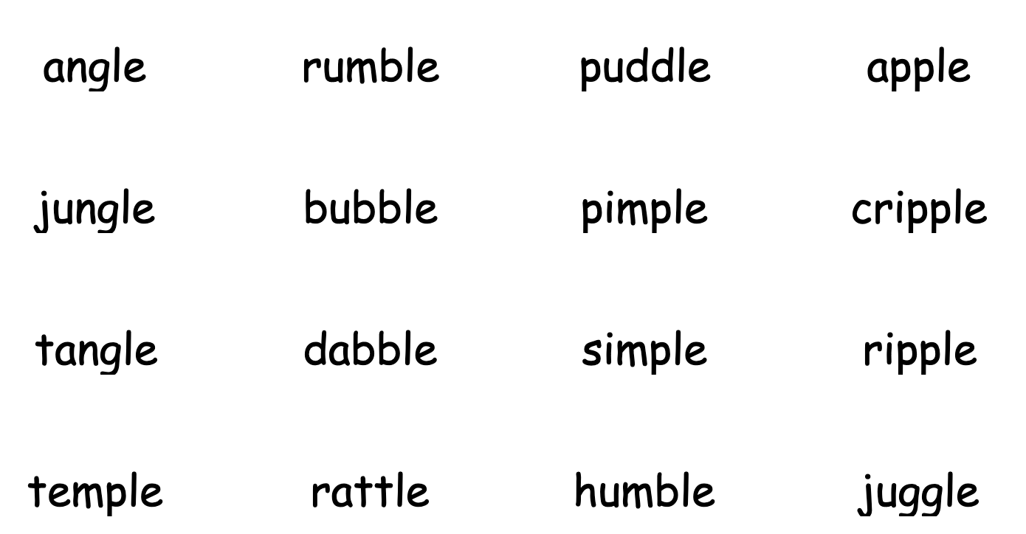
Closed/Consonant-le
-cle

Slide 50
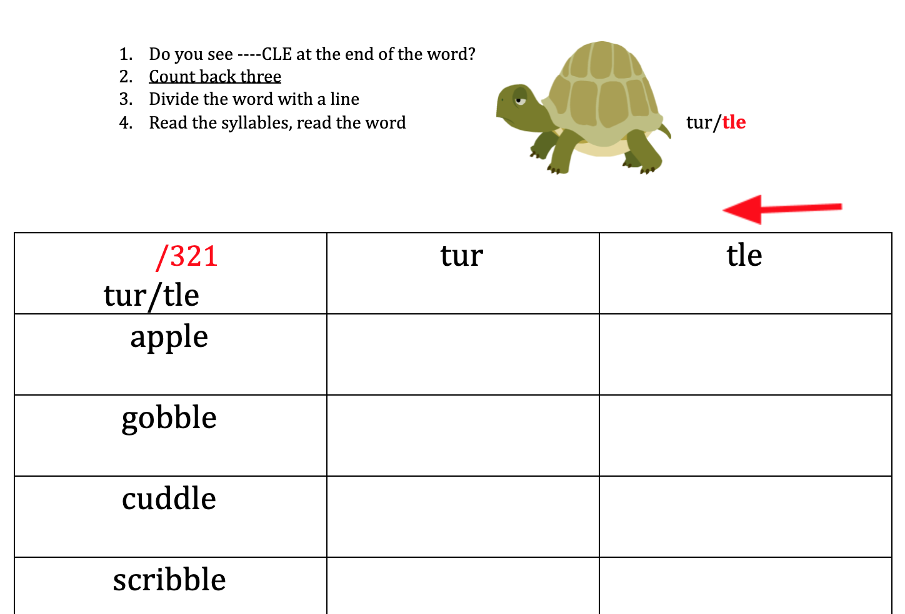

Slide 51
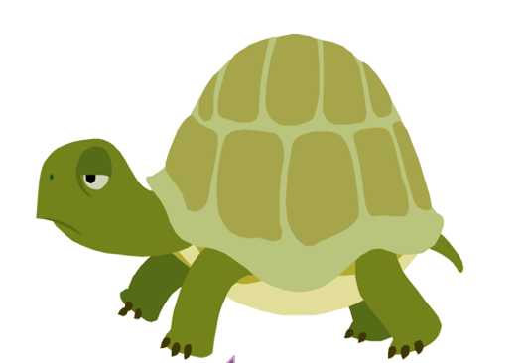
Open/Consonant-le
-cle
Open
able | bridle
bugle | cable
fable | gable
ladle | maple
noble | rifle
sable | sidle
table | stable
stifle | title
trifle | idle
cycle | ruble

Slide 52
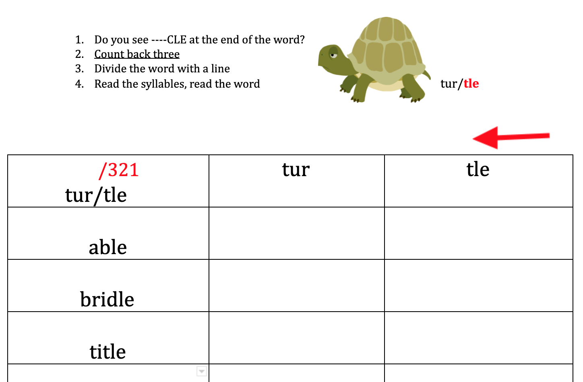

Slide 53
-cle
Closed | Open | Vowel-r | mixed
bundle | able | turtle | tumble
angle | bugle | sparkle | fable
dimple | fable | marble | hurdle
temple | ladle | startle | title
scramble | noble | burble | sparkle
tremble | sable | hurdle | single

Slide 54
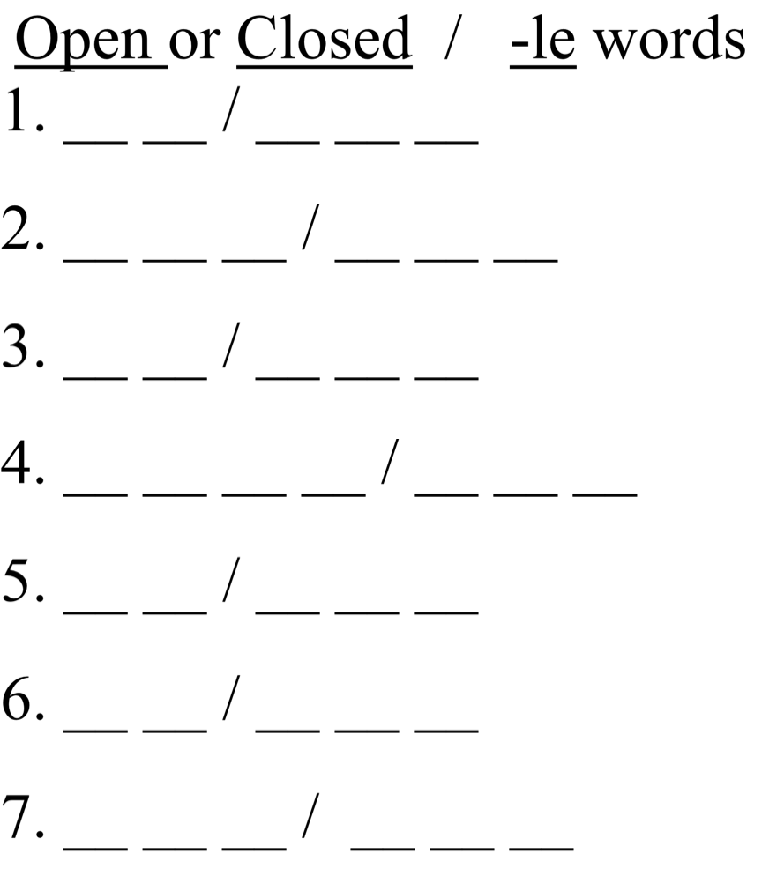

Slide 55
Open or Closed
la/dle
jum/ble
ti/tle
stum/ble
puz/zle
bu/gle
gen/tle

Slide 56
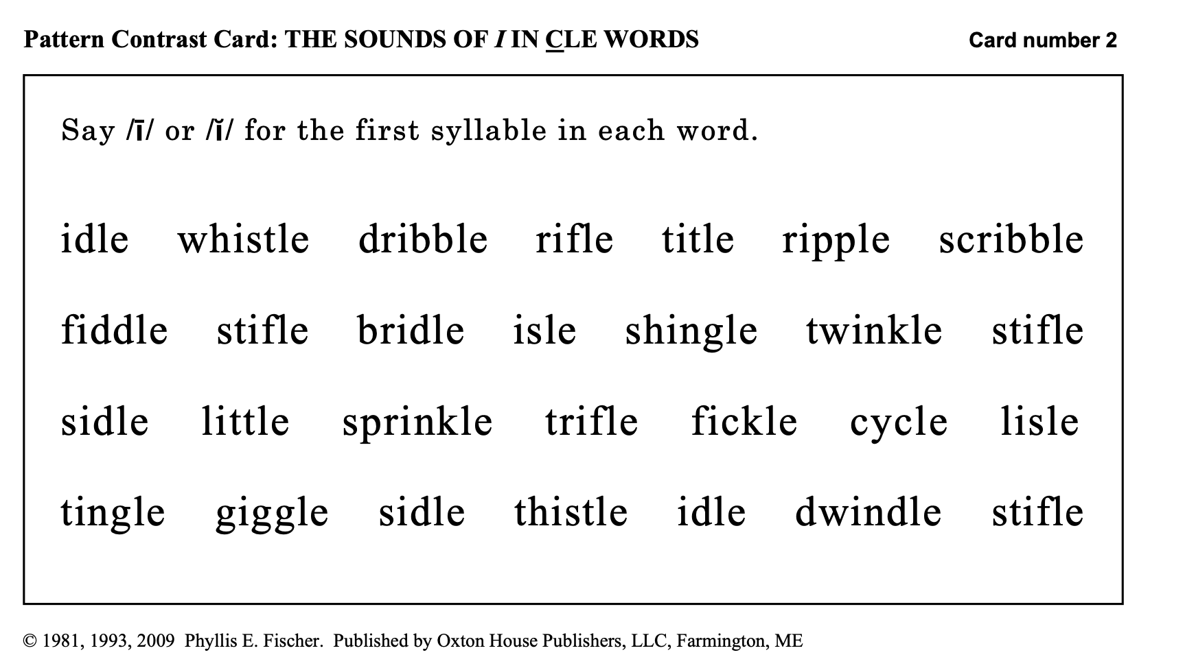
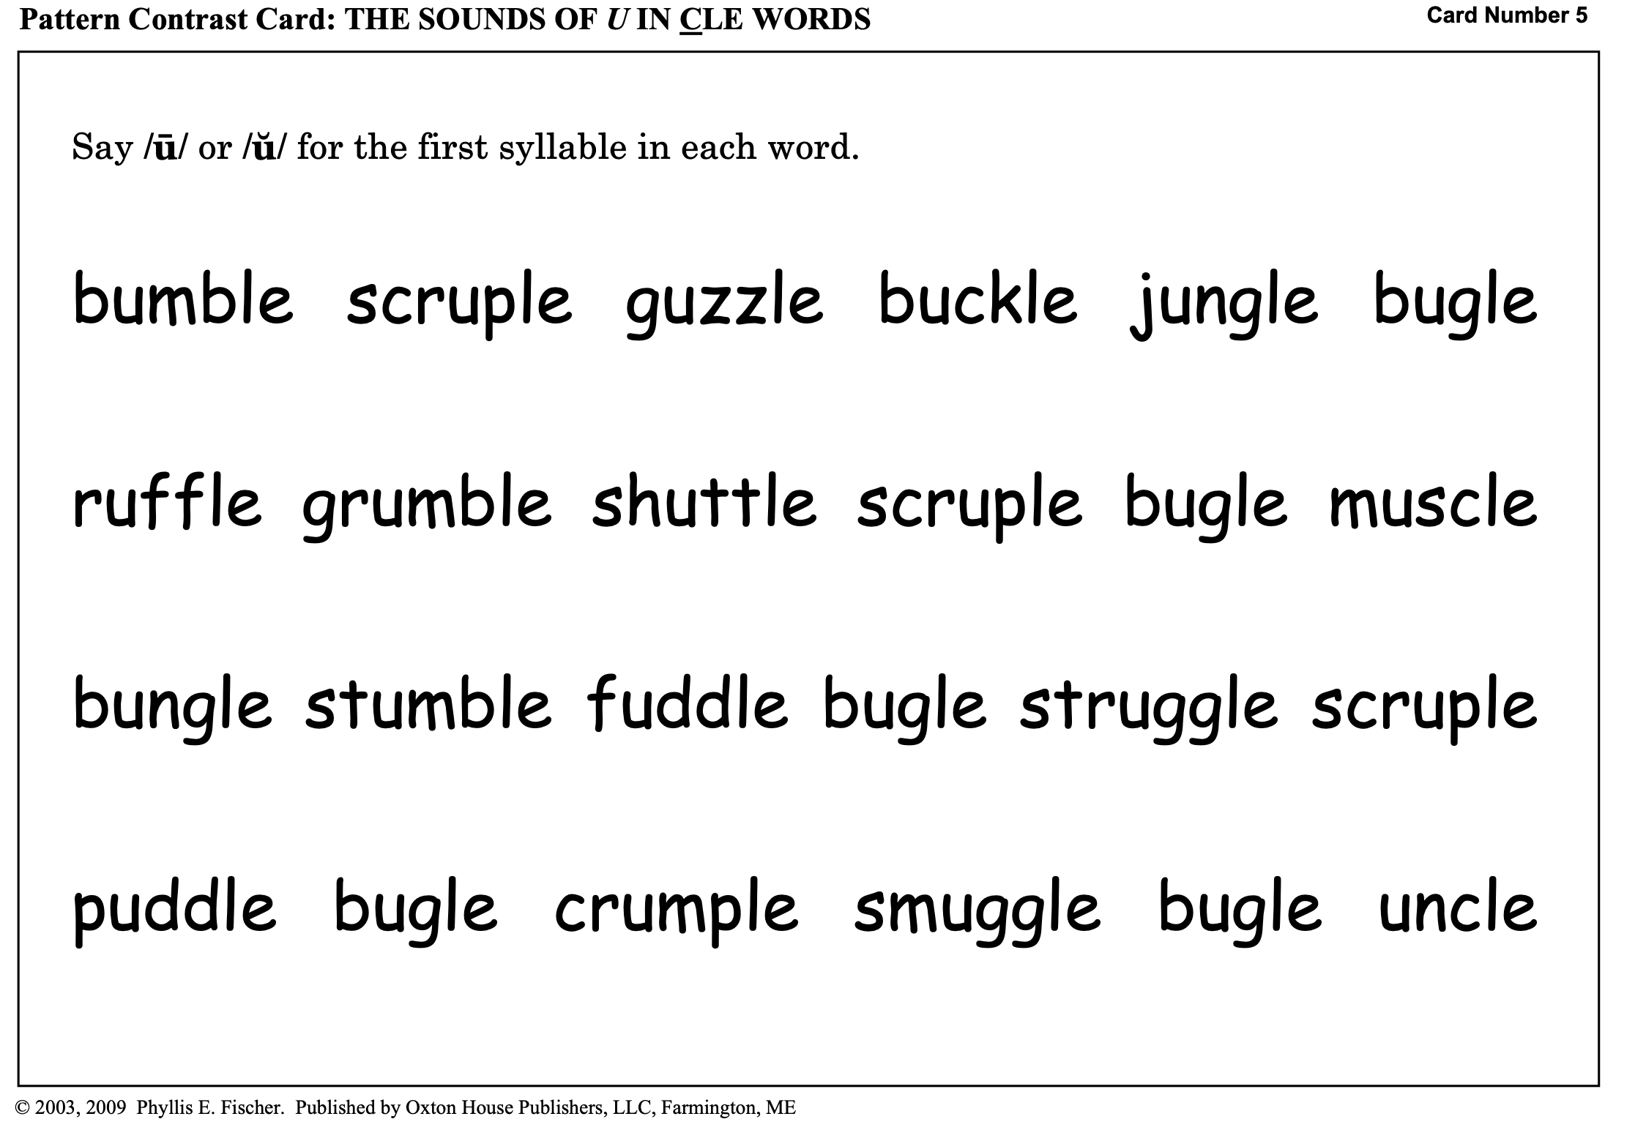
AUTOMATICITY OF READING : PHYLLIS E. FISHER – OXTON HOUSE

Slide 57
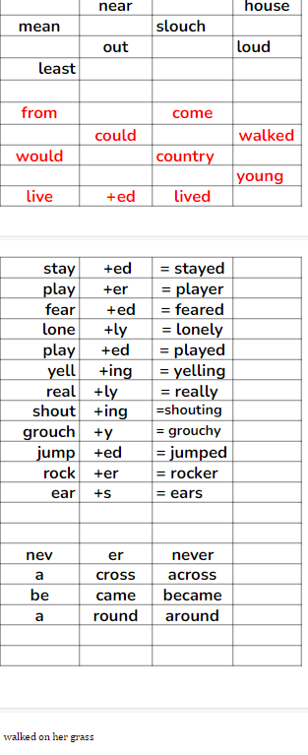
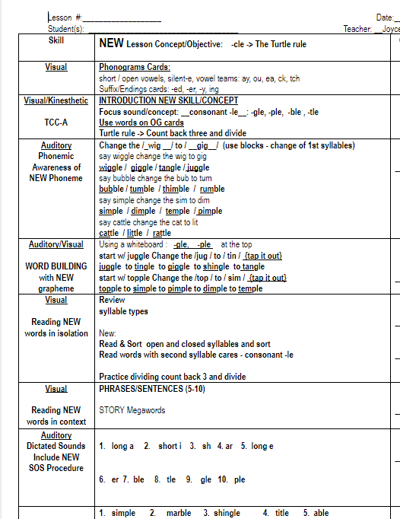
Lesson & materials are in the Drive☺

Slide 58
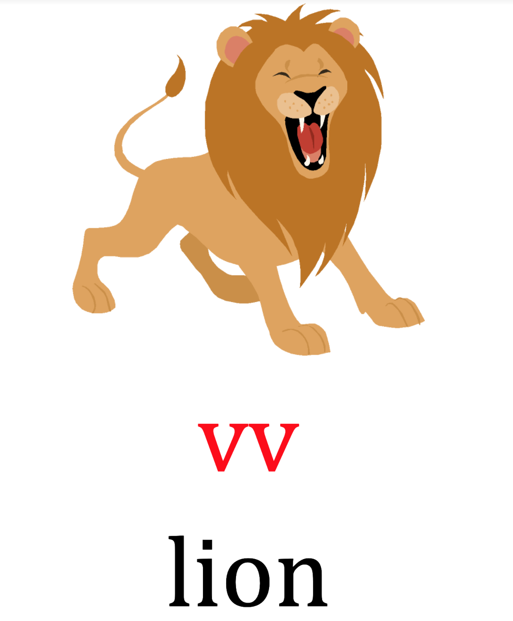
Spot & Dot the vowels (underneath)
Divide between the vowels
scooping or dividing the word
Read each syllable, read the word

Slide 59
First syllable will always be an
open syllable =
long vowel sound
Is it a vowel team? lion or loin
How many syllables does the word have? create

Slide 60

poem | iodine
riot | defiant
diet | oasis
giant | rodeo
Leo | minuet
client | pioneer
neon | violet

Slide 61
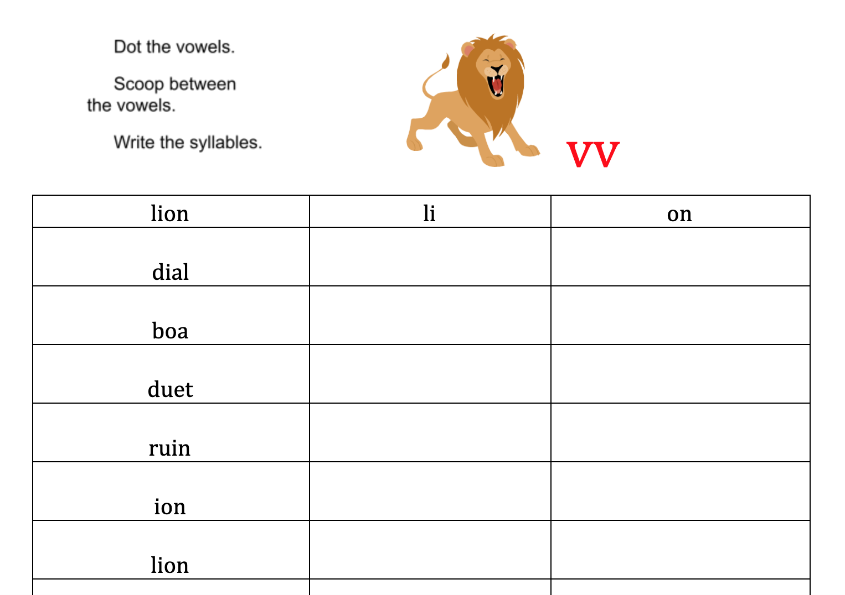

Slide 62
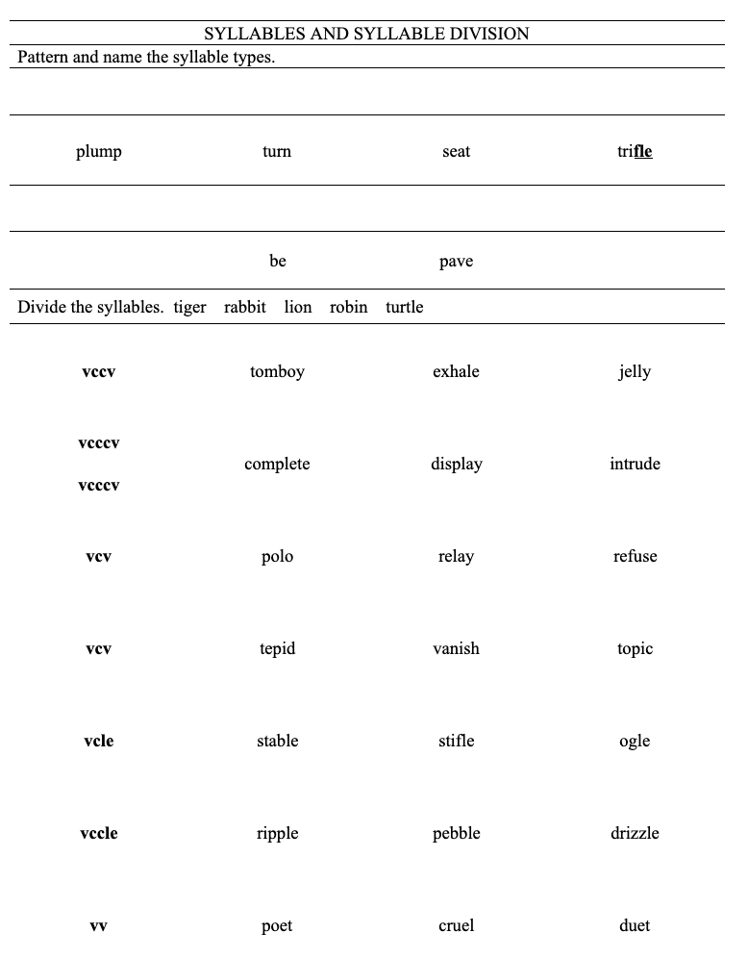
Review
&
Spiral

Slide 63
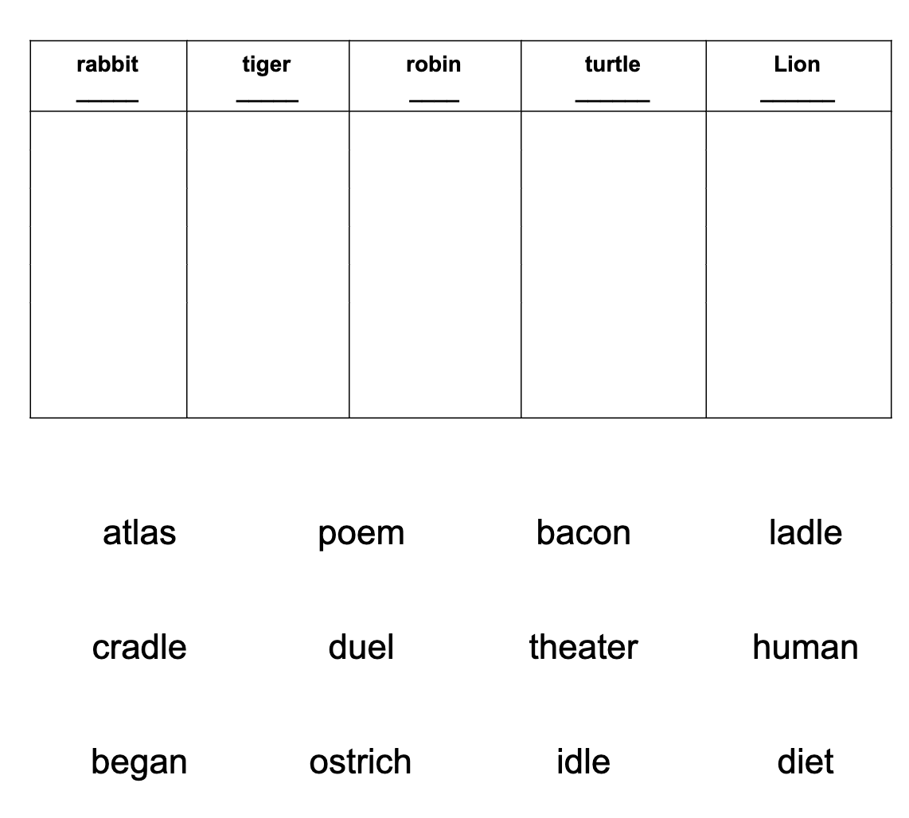
Review
&
Spiral

Slide 64
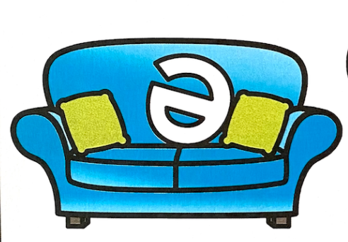
Schwa happens!
All vowels can =
/e/
It is the neutral vowel in an unaccented
or unstressed syllable.
/e/
=
/ ½ u / = /short i/ =breath
cannot hear vowel sound clearly

Slide 65
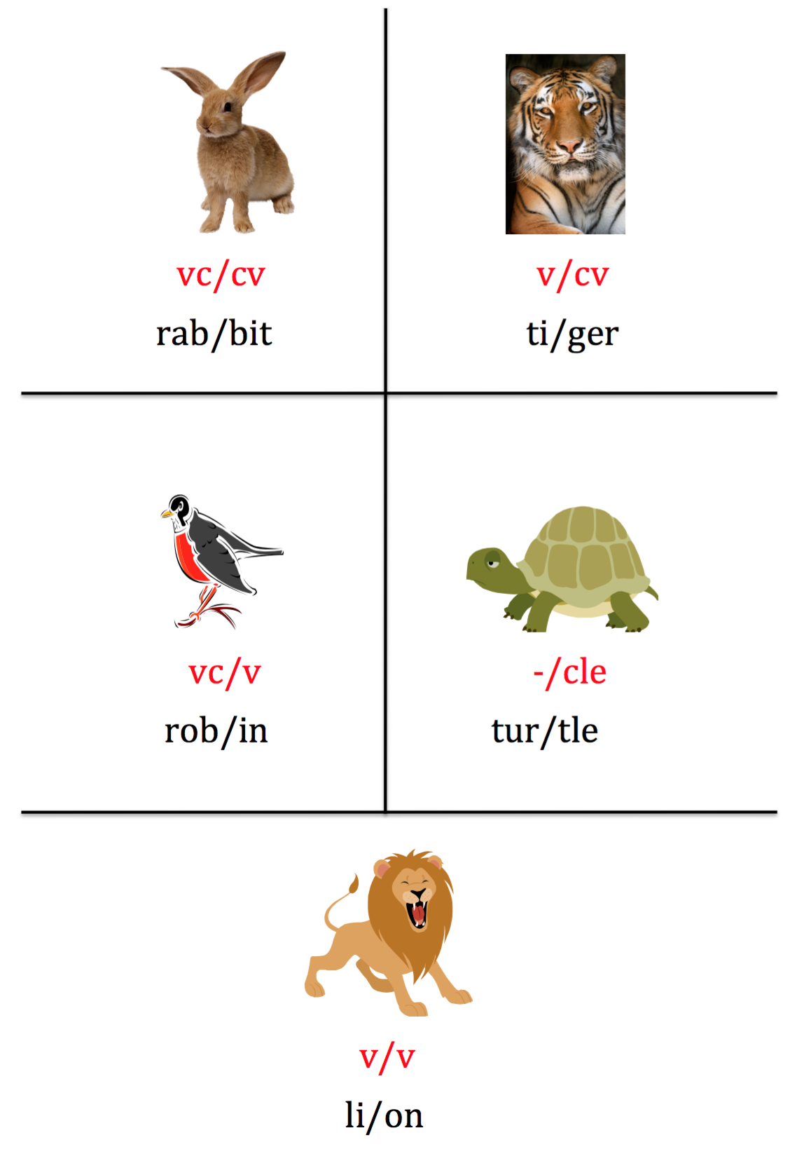

Slide 66
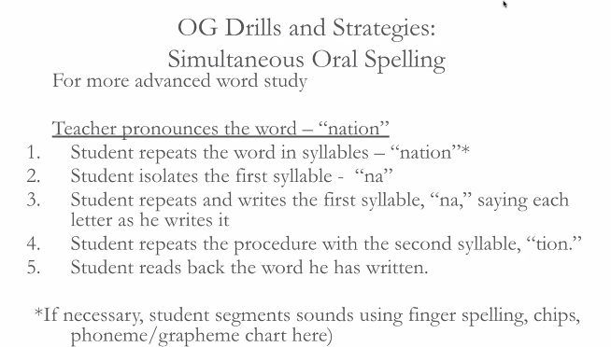
SPELLING APPROACH

