Slide 1
A Cocoa Farm
U3W3 Decodables 2.0
By Julia Lindsey
Illustrated by Meghan Shea

Slide 2
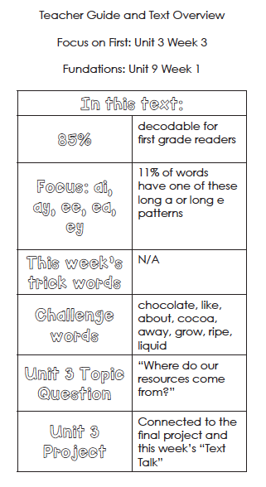

Slide 3
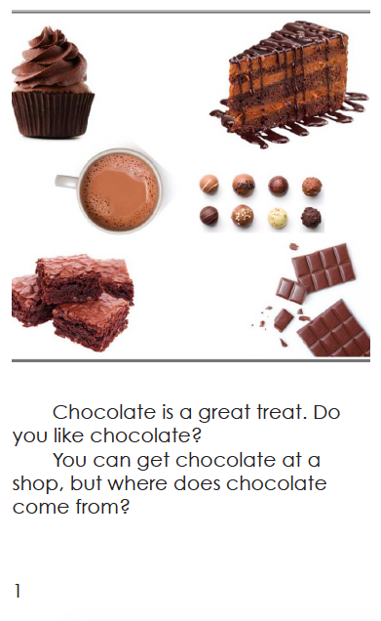

Slide 4
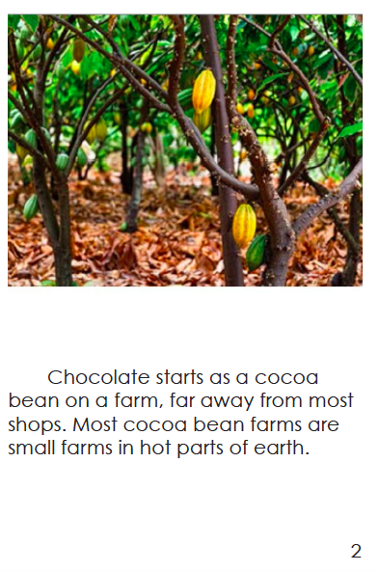

Slide 5
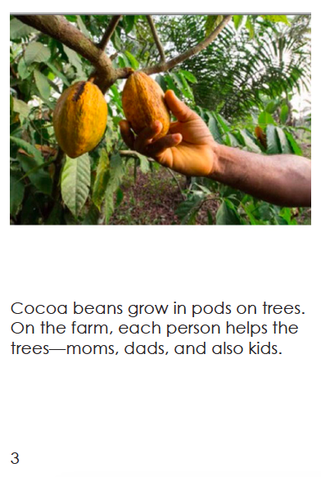

Slide 6
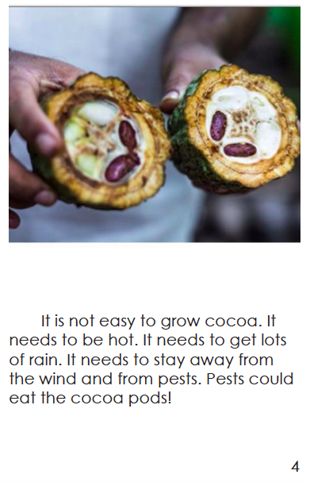

Slide 7
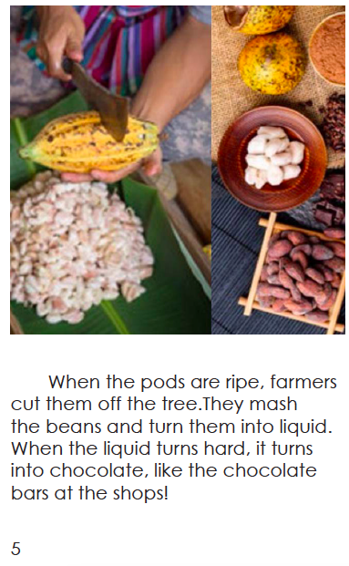

Slide 8
