Slide 1
Genius Gia
Makes a Sound
Written by Julia Lindsey
Illustrated by Meghan Shea

Slide 2


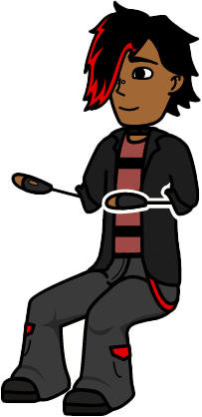
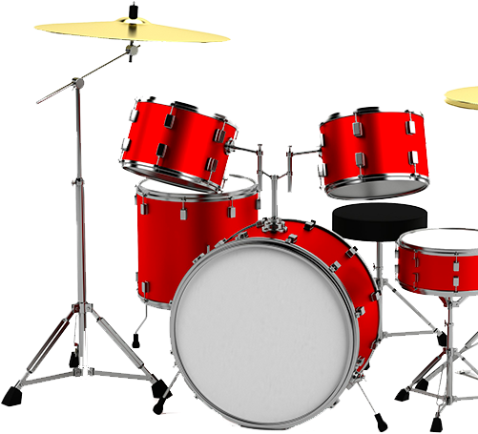
Hi! It’s me, Genius Gia. My brother, Liam, just got a drum set. Liam plays his drums a lot, and I want to join in. I want to make a guitar so I can play with Liam. Do you want to make a guitar with me?

Slide 3
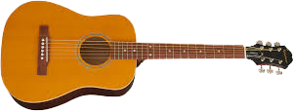

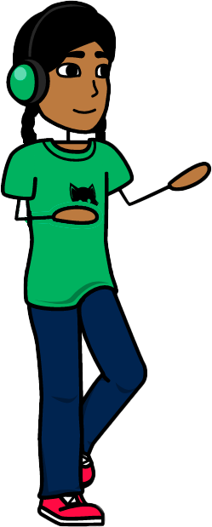
“Mom, can you help me make a guitar?”
Step 1:
Ask an adult for help so you can make your guitar. I am going to ask my mom.

Slide 4
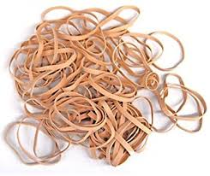
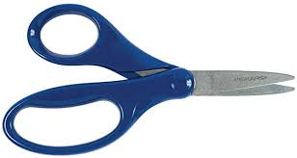
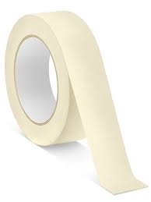
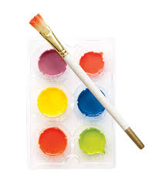
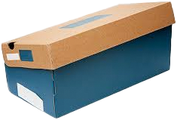
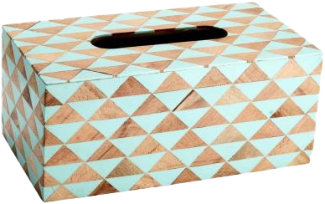
rubber bands
tape
scissors
paint
boxes
Step 2:
Get a box, an old paper tube, some rubber bands, and tape. You will also need scissors. I also got some paint!

Slide 5
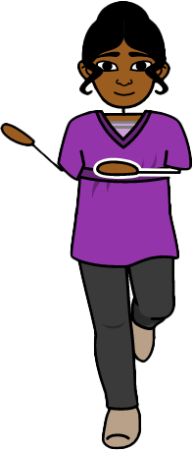
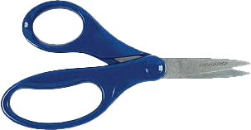
adult
rubber bands
scissors
box
Step 3:
Ask the adult to cut a hole in the box and cut each rubber band with the scissors.

Slide 6
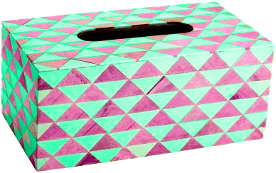
paint
Step 4:
Time to paint! I will make my guitar pink and green.

Slide 7
tape
rubber bands
tape
band
hole
Step 5:
Tape the rubber bands on one side of the hole. Stretch each rubber band over the hole. Tape it to the other side.

Slide 8
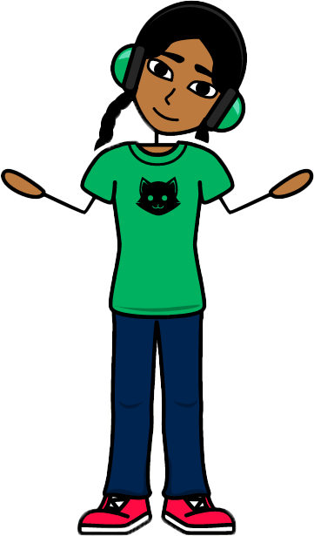
My guitar is done so I can strum, strum, strum when Liam plays his drums. We can make many sounds!
Do you want to make a guitar? What could you make that would make lots of sounds?

Slide 9
Teacher Guide 4.2: Genius Gia Makes a Sound
Decodability | 91%
Letter-Sound Focus | CVCe with suffix s
Fundations Alignment | Unit 11, Week 3
Trick Words and other High Frequency Words | want, other
Vocabulary and Challenge Words | genius, guitar, adult, paper, rubber, scissors
Fo1 Weekly Question | How do sounds change?

