Slide 1
SCHWA HAPPENS

Slide 2
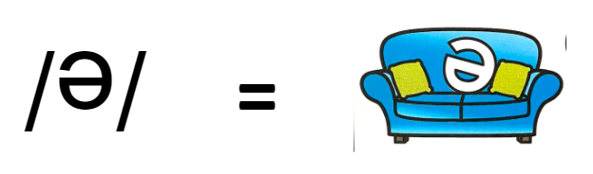
Schwa happens!
Vowels can become a schwa,
a bit lazy

Slide 3
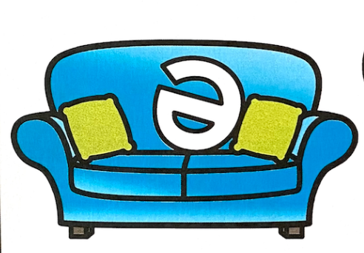
Schwa happens!
All vowels can =
/e/
It is the neutral vowel in an unaccented
or unstressed syllable.
/e/
=
/ ½ u / = /short i/ =breath
cannot hear vowel sound clearly

Slide 4
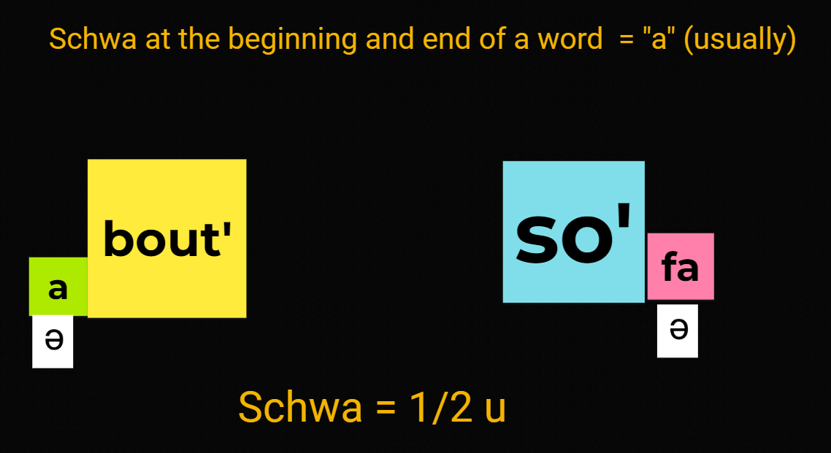

Slide 5
