Slide 1
# of Syllables 1-4

Slide 2

Notes:
🍐 This is a Pear Deck Multiple Choice Slide. Your current options are: A: Long vowel sounds, B: Short vowel sounds,
🍐 To edit the type of question or choices, go back to the "Ask Students a Question" in the Pear Deck sidebar.

Slide 3
How many Syllables?
Look at the picture. Say it outloud.
Clap out the syllables. How many do you hear?
Drag the number of syllables that you hear.
Notes:
🍐 This is a Pear Deck Draggable™ Slide.
🍐 To edit the type of question, go back to the "Ask Students a Question" in the Pear Deck sidebar.
Counting Syllables

Slide 4

Notes:
🍐 This is a Pear Deck Draggable™ Slide.
🍐 To edit the type of question, go back to the "Ask Students a Question" in the Pear Deck sidebar.
Counting Syllables

Slide 5

Notes:
🍐 This is a Pear Deck Draggable™ Slide.
🍐 To edit the type of question, go back to the "Ask Students a Question" in the Pear Deck sidebar.
Counting Syllables

Slide 6

Notes:
🍐 This is a Pear Deck Draggable™ Slide.
🍐 To edit the type of question, go back to the "Ask Students a Question" in the Pear Deck sidebar.
Counting Syllables

Slide 7

Notes:
🍐 This is a Pear Deck Draggable™ Slide.
🍐 To edit the type of question, go back to the "Ask Students a Question" in the Pear Deck sidebar.
Counting Syllables

Slide 8
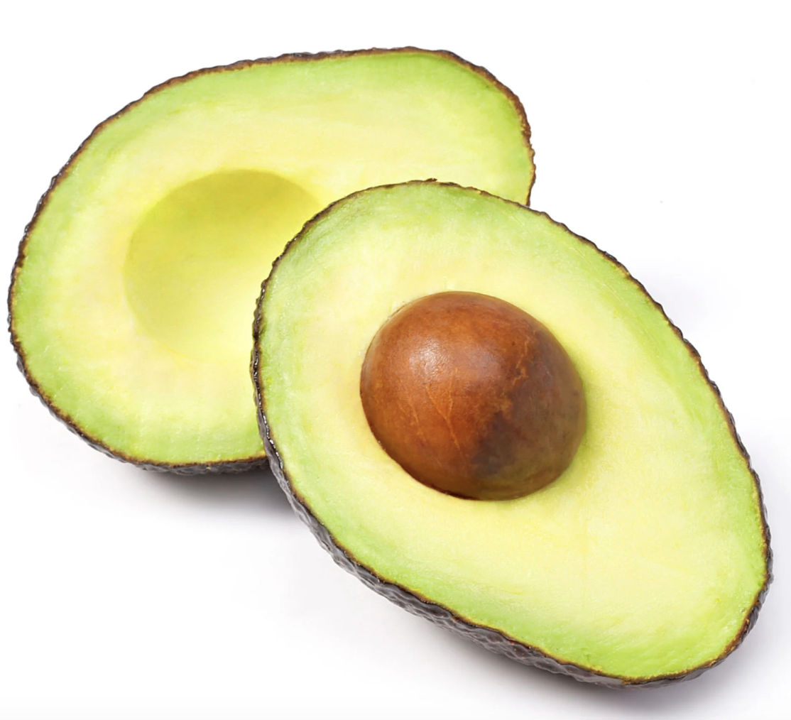
Notes:
🍐 This is a Pear Deck Draggable™ Slide.
🍐 To edit the type of question, go back to the "Ask Students a Question" in the Pear Deck sidebar.
Counting Syllables

Slide 9

Notes:
🍐 This is a Pear Deck Draggable™ Slide.
🍐 To edit the type of question, go back to the "Ask Students a Question" in the Pear Deck sidebar.
Counting Syllables

Slide 10

Notes:
🍐 This is a Pear Deck Draggable™ Slide.
🍐 To edit the type of question, go back to the "Ask Students a Question" in the Pear Deck sidebar.
Counting Syllables

Slide 11

Notes:
🍐 This is a Pear Deck Draggable™ Slide.
🍐 To edit the type of question, go back to the "Ask Students a Question" in the Pear Deck sidebar.
Counting Syllables

Slide 12
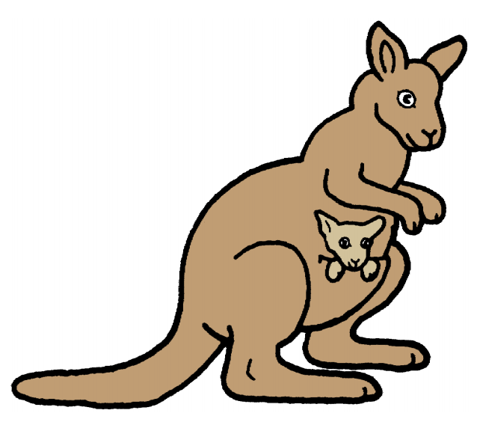
Notes:
🍐 This is a Pear Deck Draggable™ Slide.
🍐 To edit the type of question, go back to the "Ask Students a Question" in the Pear Deck sidebar.
Counting Syllables

Slide 13
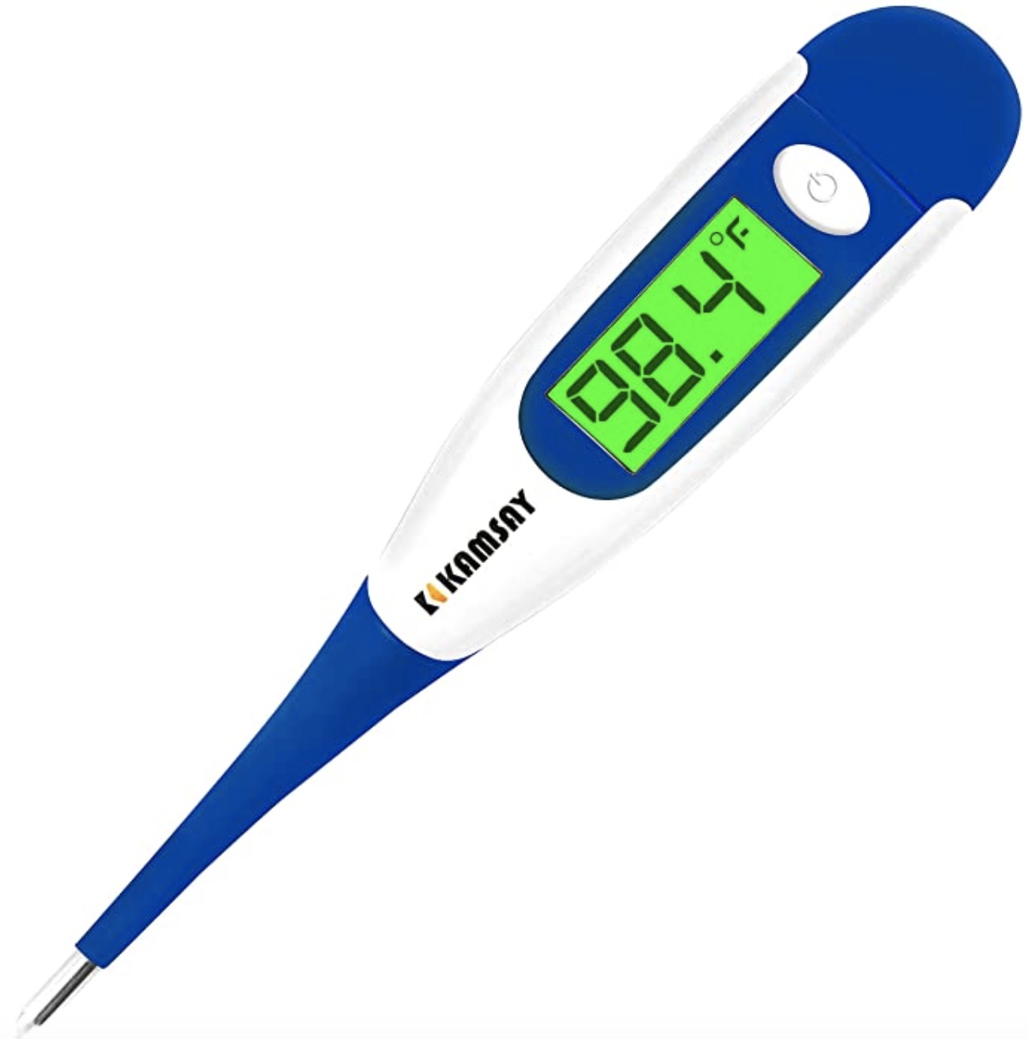
Notes:
🍐 This is a Pear Deck Draggable™ Slide.
🍐 To edit the type of question, go back to the "Ask Students a Question" in the Pear Deck sidebar.
Counting Syllables

